Slide 1


Soputhik SENG
05/23/2023

Slide 2

Outline
Executive Summary
Introduction
Methodology
Results
Conclusion
Appendix

Slide 3
Executive Summary
Summary of methodologies
The methodologies used in this course are all
Summary of all results

Slide 4
Introduction
Project background and context
Problems you want to find answers

Slide 5

Section 1

Slide 6
Methodology
Executive Summary
Data collection methodology:
Data was collected using the SpaceX API in addition to Web Scraping from Wikipedia
Perform data wrangling
The Data was first checked for Null Values, which was dealt with accordingly, we then reduce the data features on landing outcomes to better visualize the success rate
Perform exploratory data analysis (EDA) using visualization tools such as Seaborn, Matplotlib and SQL
Perform interactive visual analytics using Folium and Plotly Dash
Perform predictive analysis using classification models
We used the Wrangled data and split into train and test set before training it using multiple models to find out that all models work similarly on the data.

Slide 7
Data Collection
There were two main sources of the data that was used for our models
One of the data was achieved through the SpaceX API where we extracted it by calling specifically to the Rest API using a series of helper functions to be able to extract every single data that is useful for our model.
The other data set was done through Web Scraping on the Wikipedia site to get additional data that were not included in the SpaceX API such as the booster landing outcome, payload mass, and more.

Slide 8
Data Collection – SpaceX API
Present your data collection with SpaceX REST calls using key phrases and flowcharts
Add the GitHub URL of the completed SpaceX API calls notebook (must include completed code cell and outcome cell), as an external reference and peer-review purpose
Place your flowchart of SpaceX API calls here

Slide 9
Data Collection - Scraping
Present your web scraping process using key phrases and flowcharts
Add the GitHub URL of the completed web scraping notebook, as an external reference and peer-review purpose
Place your flowchart of web scraping here

Slide 10
Data Wrangling
Describe how data were processed
You need to present your data wrangling process using key phrases and flowcharts
Add the GitHub URL of your completed data wrangling related notebooks, as an external reference and peer-review purpose

Slide 11
EDA with Data Visualization
Summarize what charts were plotted and why you used those charts
Add the GitHub URL of your completed EDA with data visualization notebook, as an external reference and peer-review purpose

Slide 12
EDA with SQL
Using bullet point format, summarize the SQL queries you performed
Add the GitHub URL of your completed EDA with SQL notebook, as an external reference and peer-review purpose

Slide 13
Build an Interactive Map with Folium
Summarize what map objects such as markers, circles, lines, etc. you created and added to a folium map
Explain why you added those objects
Add the GitHub URL of your completed interactive map with Folium map, as an external reference and peer-review purpose

Slide 14
Build a Dashboard with Plotly Dash
Summarize what plots/graphs and interactions you have added to a dashboard
Explain why you added those plots and interactions
Add the GitHub URL of your completed Plotly Dash lab, as an external reference and peer-review purpose

Slide 15
Predictive Analysis (Classification)
Summarize how you built, evaluated, improved, and found the best performing classification model
You need present your model development process using key phrases and flowchart
Add the GitHub URL of your completed predictive analysis lab, as an external reference and peer-review purpose

Slide 16
Results
Exploratory data analysis results
Interactive analytics demo in screenshots
Predictive analysis results

Slide 17

Section 2

Slide 18
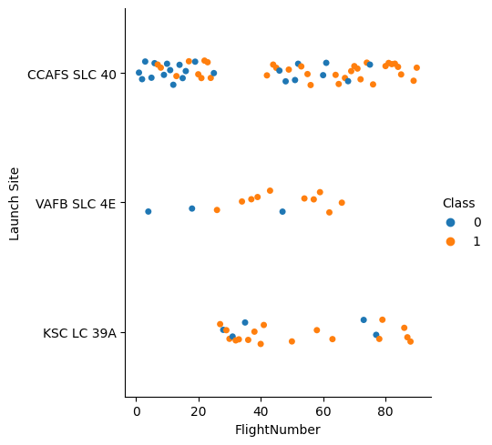
Flight Number vs. Launch Site
As you can see from the scatter chart you can see that the majority launches are made from Launch Site “CCAFS SLC 40”
The majority of the first 20 flights has a very small success rate, but as the flight number increases, the success rate starts to increase.

Slide 19
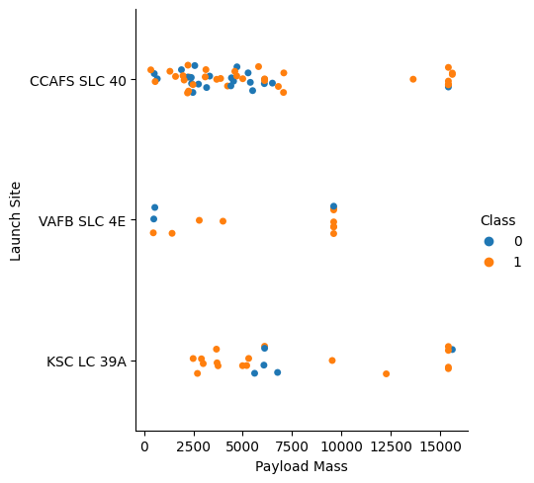
Payload vs. Launch Site
Most of the launches are made with a payload of around 7500 kg or less.
However, as the payload gets over 7500 kg, we see a higher success rate.

Slide 20
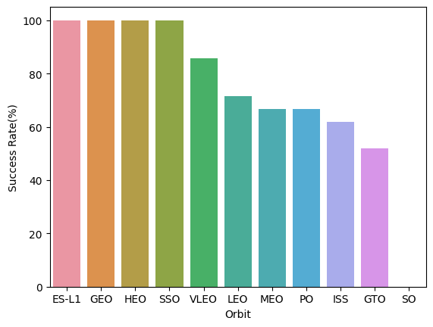
Success Rate vs. Orbit Type
Launches with payload going to the ES-L1, GEO, HEO, and SSO orbit all have 100% success rate.

Slide 21
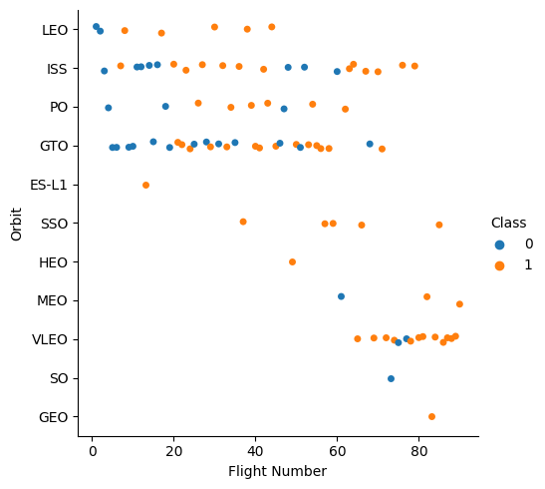
Flight Number vs. Orbit Type
We can see a lot of variety of the orbit types that SpaceX launches to, particularly only 4 of 11 types of orbit were only launched once.
SpaceX launched most of its payload to LEO, ISS, PO, GTO, and VLEO type orbit.

Slide 22
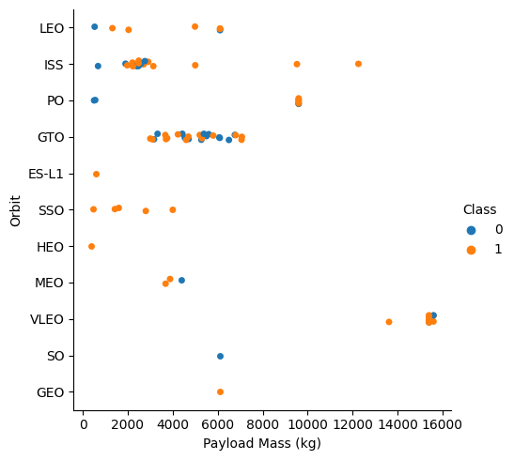
Payload vs. Orbit Type
Most of the payload being sent to orbit have a mass of less 8000 kg
Only the ISS, PO, and VLEO orbit type have send payload with masses of over 8000 kilograms to orbit.

Slide 23
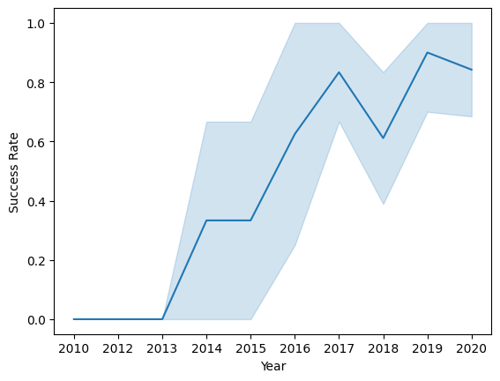
Launch Success Yearly Trend
At the beginning launches were very unsuccessful with a 0% rate
It started to increase as more flights and tests were made as it reached 80% in 2017.
There were a small dip in the success rate during 2018 but recovered to over 80 percent in 2019.

Slide 24
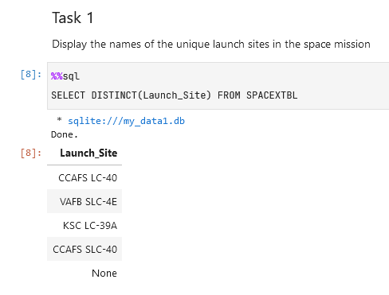
All Launch Site Names
There are 4 unique Launch Sites that SpaceX mainly uses for Falcon 9 launches mainly they are: CCAFS LC-40, VAFB SLC-4E, KSC LC-39A, and CCAFS SLC-40

Slide 25
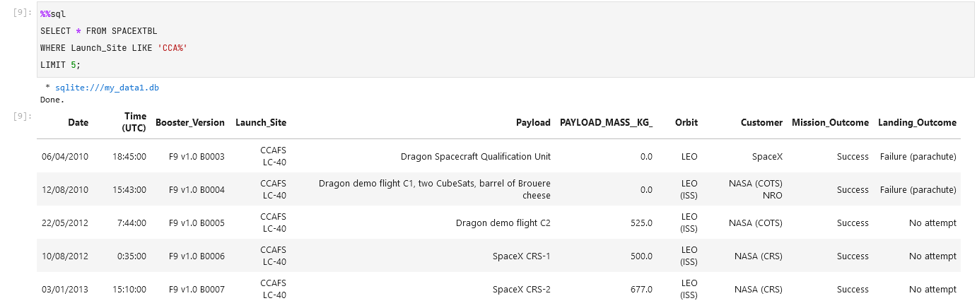
Launch Site Names Begin with 'CCA'
The first five launches made from the site that begins with CCA are as follows:
4 of which have NASA as the Customer, while the other being SpaceX

Slide 26
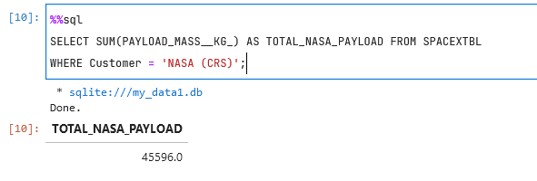
Total Payload Mass
The Falcon 9 has totally transported 45596 kilograms worth of payload during every single one of its missions.

Slide 27
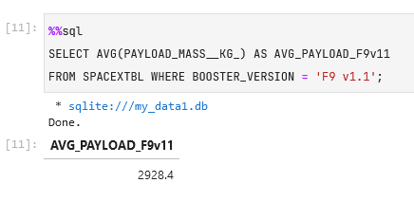
Average Payload Mass by F9 v1.1
Among the total 45596 kilograms worth of payload that was transported, 2928.4 kilograms was done so by the Falcon 9 v1.1.

Slide 28
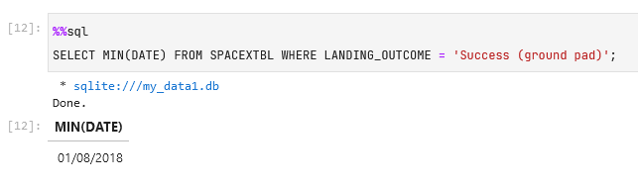
First Successful Ground Landing Date
The first successful landing on a ground pad was made on the 1st of August, 2018.

Slide 29
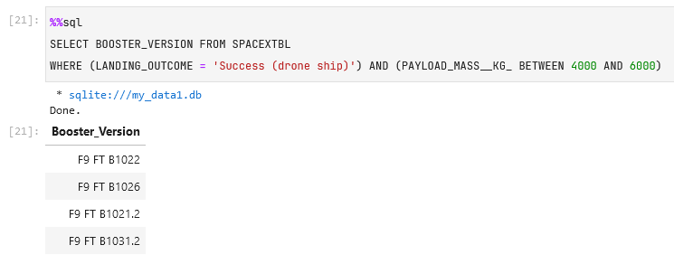
Successful Drone Ship Landing with Payload between 4000 and 6000
There were four different Falcon 9 versions that were able to successfully carry a payload of 4000 to 6000 kilograms and were then able to successfully land on a drone ship. They are F9 FT B1022, F9 FT B1026, F9 FT B1021.2, and F9 FT B1031.2.

Slide 30
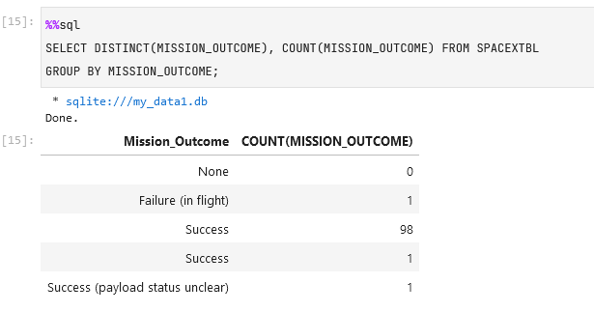
Total Number of Successful and Failure Mission Outcomes
Out of the total 101 launches, 100 were considered a success by SpaceX and only 1 were considered a Failure.

Slide 31
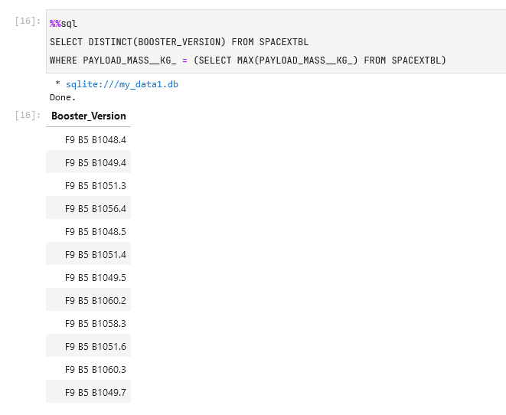
Boosters Carried Maximum Payload
There are totally 12 different Booster Versions that were able to carry the max payload, they are shown in the image to the right.

Slide 32
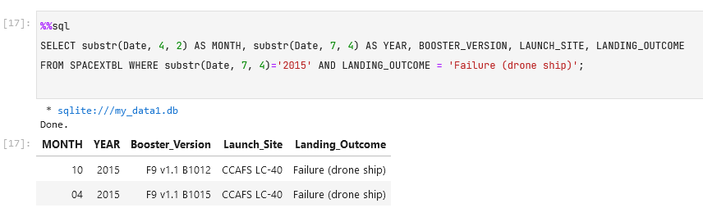
2015 Launch Records
There were two different landing failures when trying to land on the drone ship in the year 2015. Both launches were made from the Launch Site CCAFS LC-40.

Slide 33
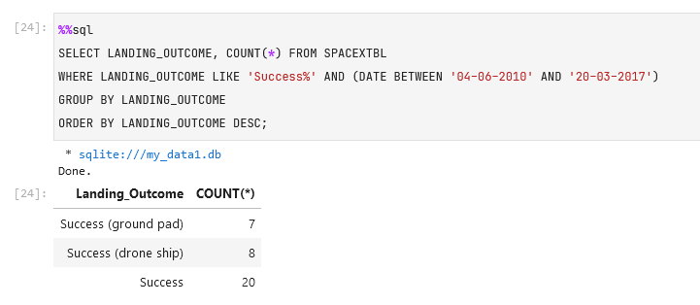
Rank Landing Outcomes Between 2010-06-04 and 2017-03-20
During the period, there were totally 35 successful launch outcomes, 7 on the ground pad, 8 on the drone ship, and 20 other success outcomes.

Slide 34

Section 3

Slide 35
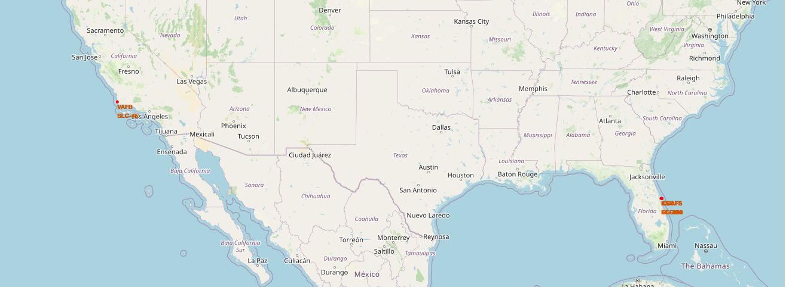
Launch Sites Location
There are four main launch sites, three were located on the east coast of Florida and one on the west coast of California. All sites also have proximity towards the equator.

Slide 36
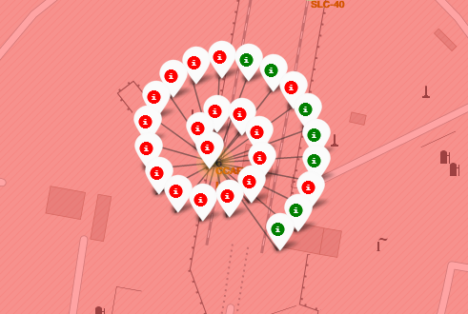
Success/Failure Launches on site CCAFS LC-40
Many of the launches made on the launch site CCAFS LC-40 fails. The site is located on the East Coast in Florida. There were a total of 26 launches.

Slide 37
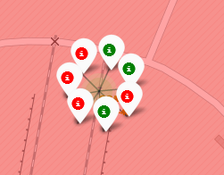
Success/Failure Launches on site CCAFS SLC-40
Many of the launches made on the launch site CCAFS SLC-40 succeeded, but there were a lot less launches with only 7 that were made here, although it is right next to CCAFS LC-40.

Slide 38
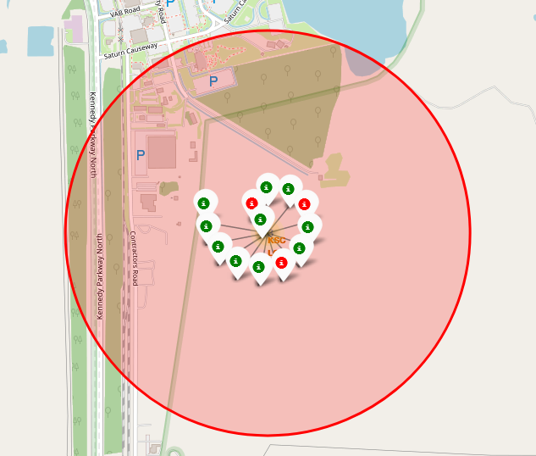
Success/Failure Launches on site KSC LC-39A
Another launch site in the vicinity of Florida, they were a total of 13 launches here the majority of which succeeded with only 3 failures.

Slide 39
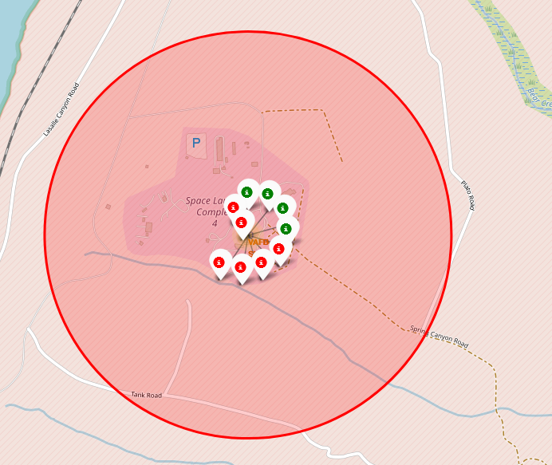
Success/Failure Launches on site VAFB SLC-4E
Contrary to the rest, this site is located on the West Coast, in California. There were totally 10 launches here with a 40% success rate.

Slide 40
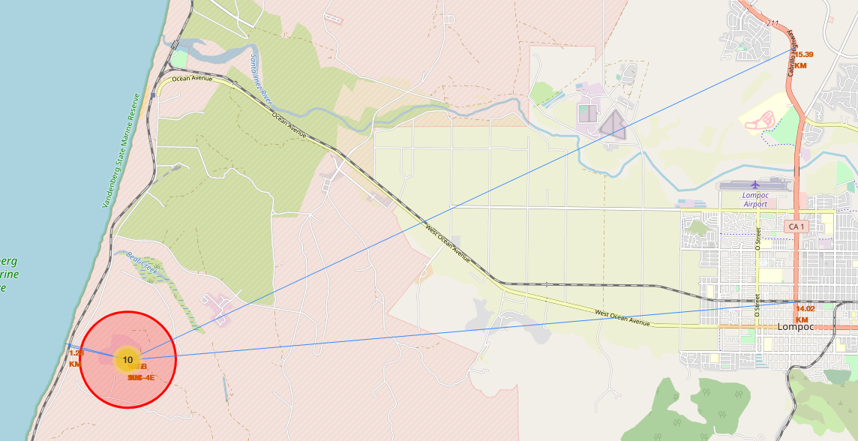
VAFB SLC-4E Proximity to Civilian Infrastructure
As shown the launch site is quite close to the coast the distance of only a bit over a kilometer to a coast and a railway, however, it is quite distant from the closest city and highway.

Slide 41

Section 4

Slide 42
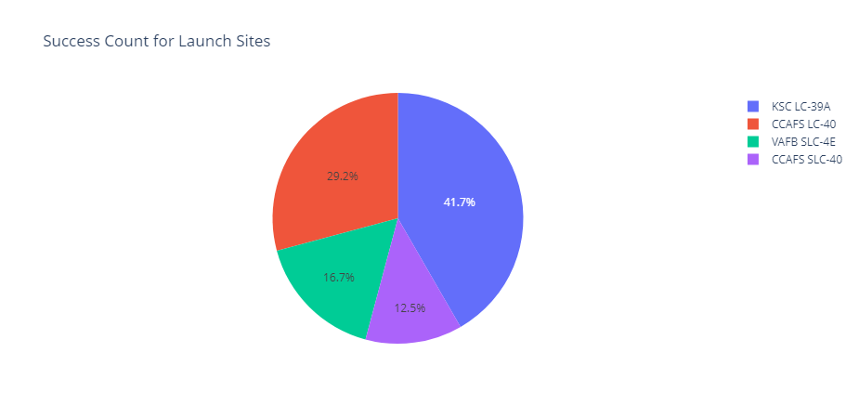
Launch Sites Success Rate
The highest rates among all four launch sites is site KSC LC-39A, it is located on the Florida coast, west ward of the two other coasts located there as well.
The least successful site is CCAFS SLC-40.

Slide 43
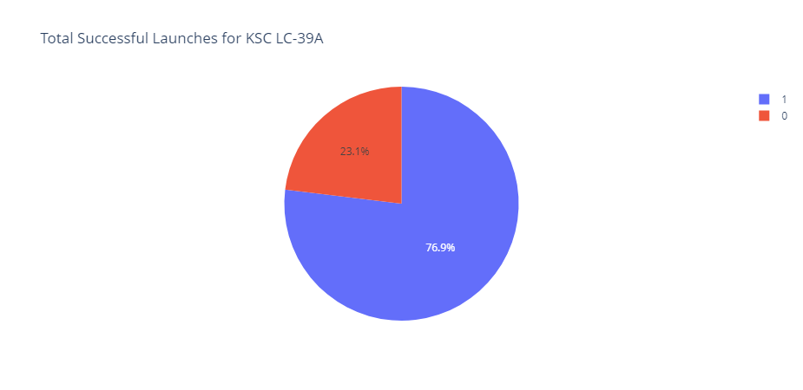
Highest Success Rate Launch Site: KSC LC-39A
The launch site KSC LC-39A has the highest success to failure ratio standing at 79.6%.

Slide 44
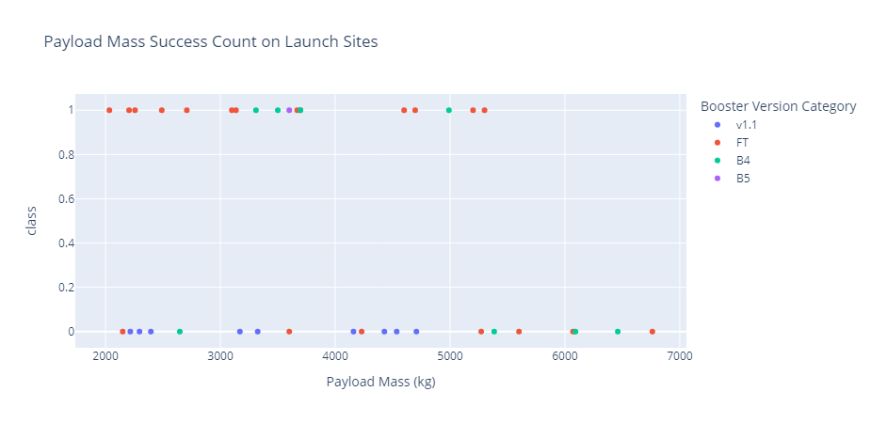
Payload Mass Success Count
Based on its payload we could see that the booster with payload less than 4000 is that has the version of FT, B4, and B5 has high success rates, while booster v1.1 has not succeeded at all.

Slide 45

Section 5

Slide 46
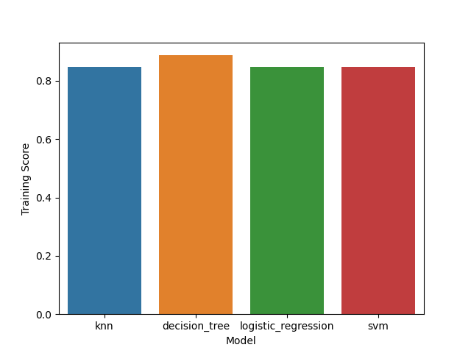
Classification Accuracy: Training Scores
Among all models that were created, the Decision Tree Model created the model that works best with the Training Data.

Slide 47
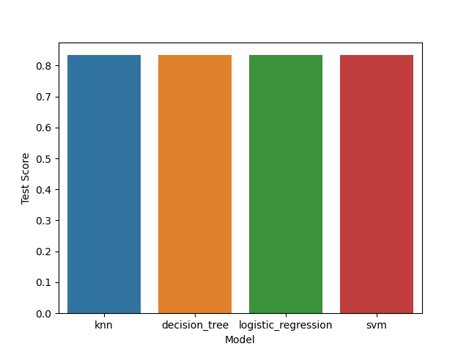
Classification Accuracy: Testing Scores
During testing, we found out that all models work the same with all receiving test scores of 0.8333.

Slide 48
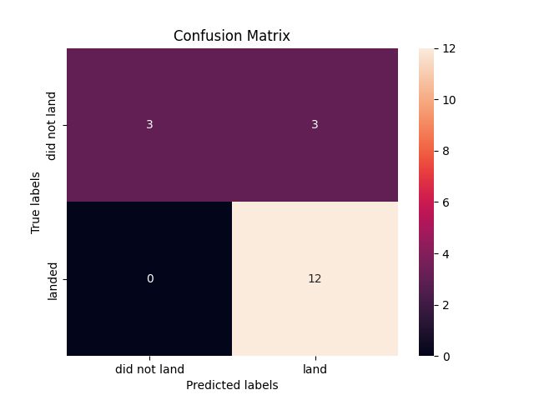
Confusion Matrix
When we look deeper into the confusion matrix, we see that all four models produced the exact same matrix.
They received 100% accuracy on True Positives, but only 50% accuracy with True Negatives when compared to False Positives.

Slide 49
Conclusions
We found out that all launch sites are in extremely close to the equator and the coasts.
SpaceX started the Falcon9 with a rocky success rate, but it started to stabilize and became more successful as launches increase.
The most successful launch site is the KSC LC-39A launch site.
The Falcon 9 has transported 45596 kilograms worth of payload among the data provided in the data set.
Most of the launches are made with a payload of around 7500 kg or less.
SpaceX launched most of its payload to LEO, ISS, PO, GTO, and VLEO type orbit.
With the model we have created, we are only able to accurately predict the outcome only 83.33% of the time.

Slide 50
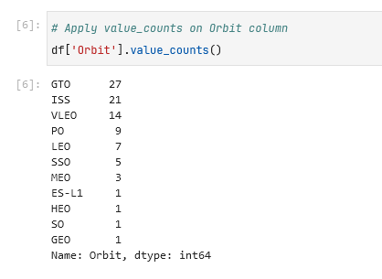
Appendix
The GTO orbit type, has the highest number of payload sent to.

Slide 51


